Slide 1
Accessibility – Enhance the modal infrastructure to correct the focus on exiting a modal.
Date of the presentation
Notes:
To be updated when meeting will be organized.

Slide 2
Problem 1: Modal can be called from multiple places in the application.

Slide 3
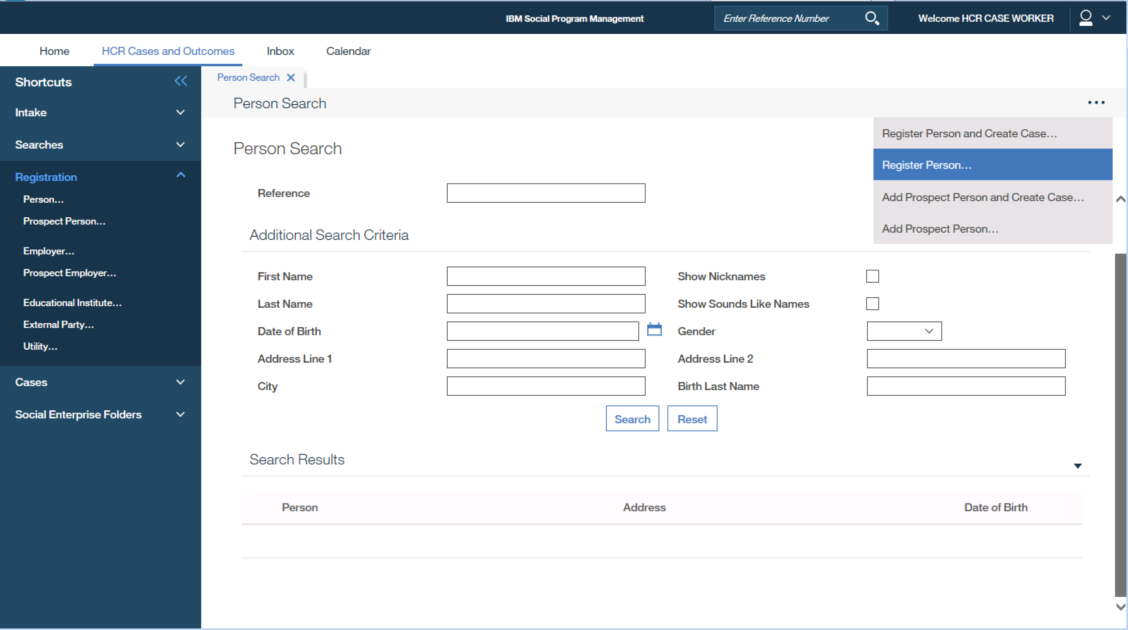
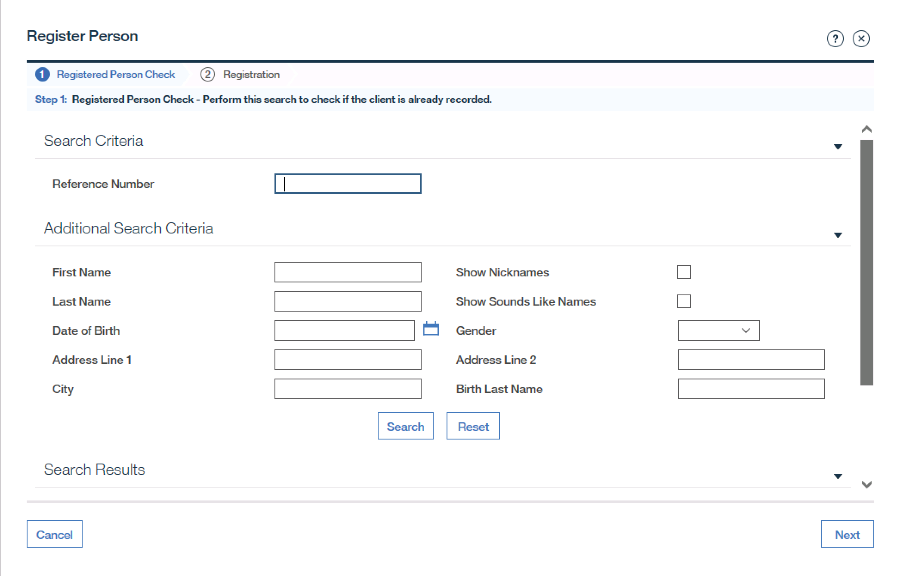
Registering a Person
Notes:
Currently, if user exits out of a modal there are inconsistencies to where they are returned.
User can open, invoke a modal from various places in our application, those places will be then called invocation points in this presentation.
An example is the Person Registration modal which has the following invocation points:
Smart Navigator,
Shortcut Panel, and
Page level Action Menu.
Another example is the page action control when adding a new evidence- for example new contact details.

Slide 4
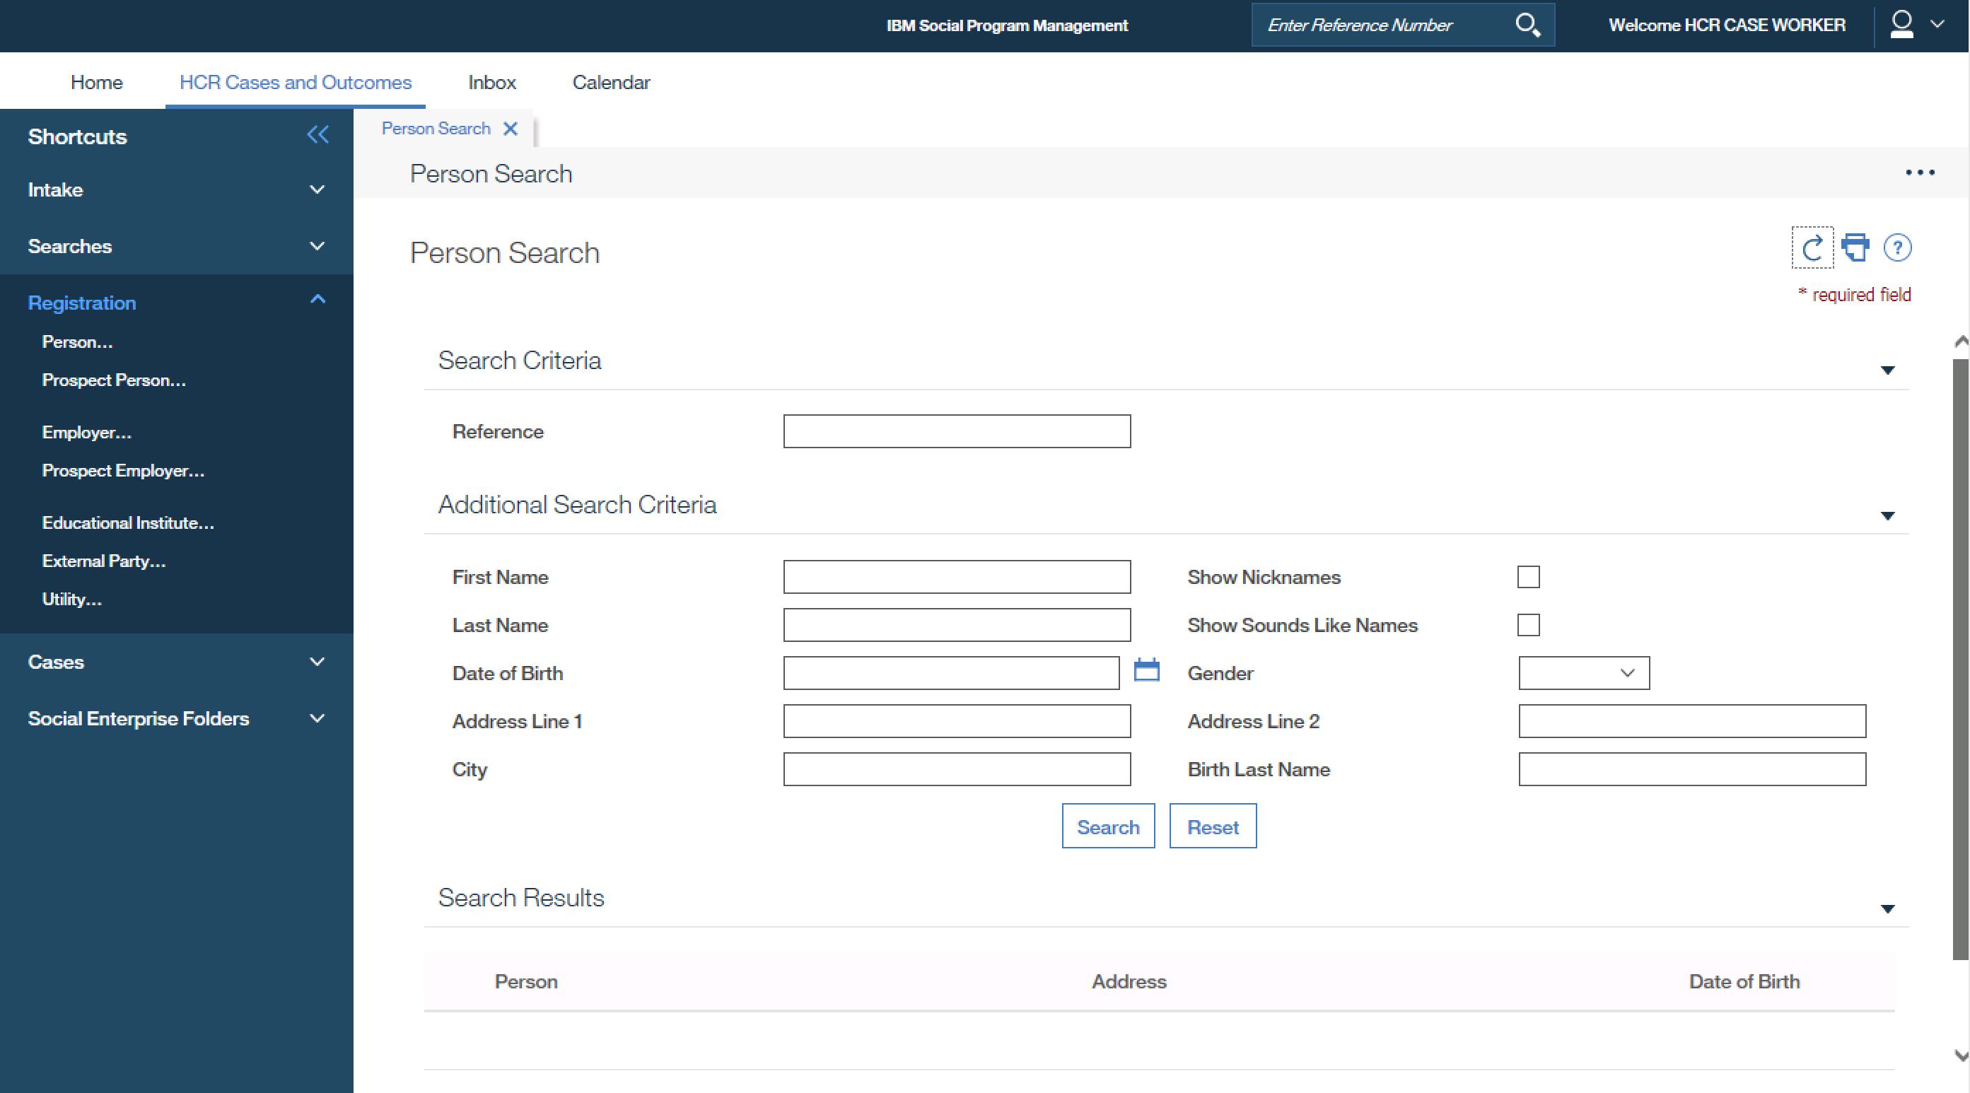
Focus is return to the refresh icon of the Person Search Tab
Notes:
User exiting out of the Person Registration Modal may be returned to the following areas:
The first button on an opened tab in this case a refresh button.

Slide 5
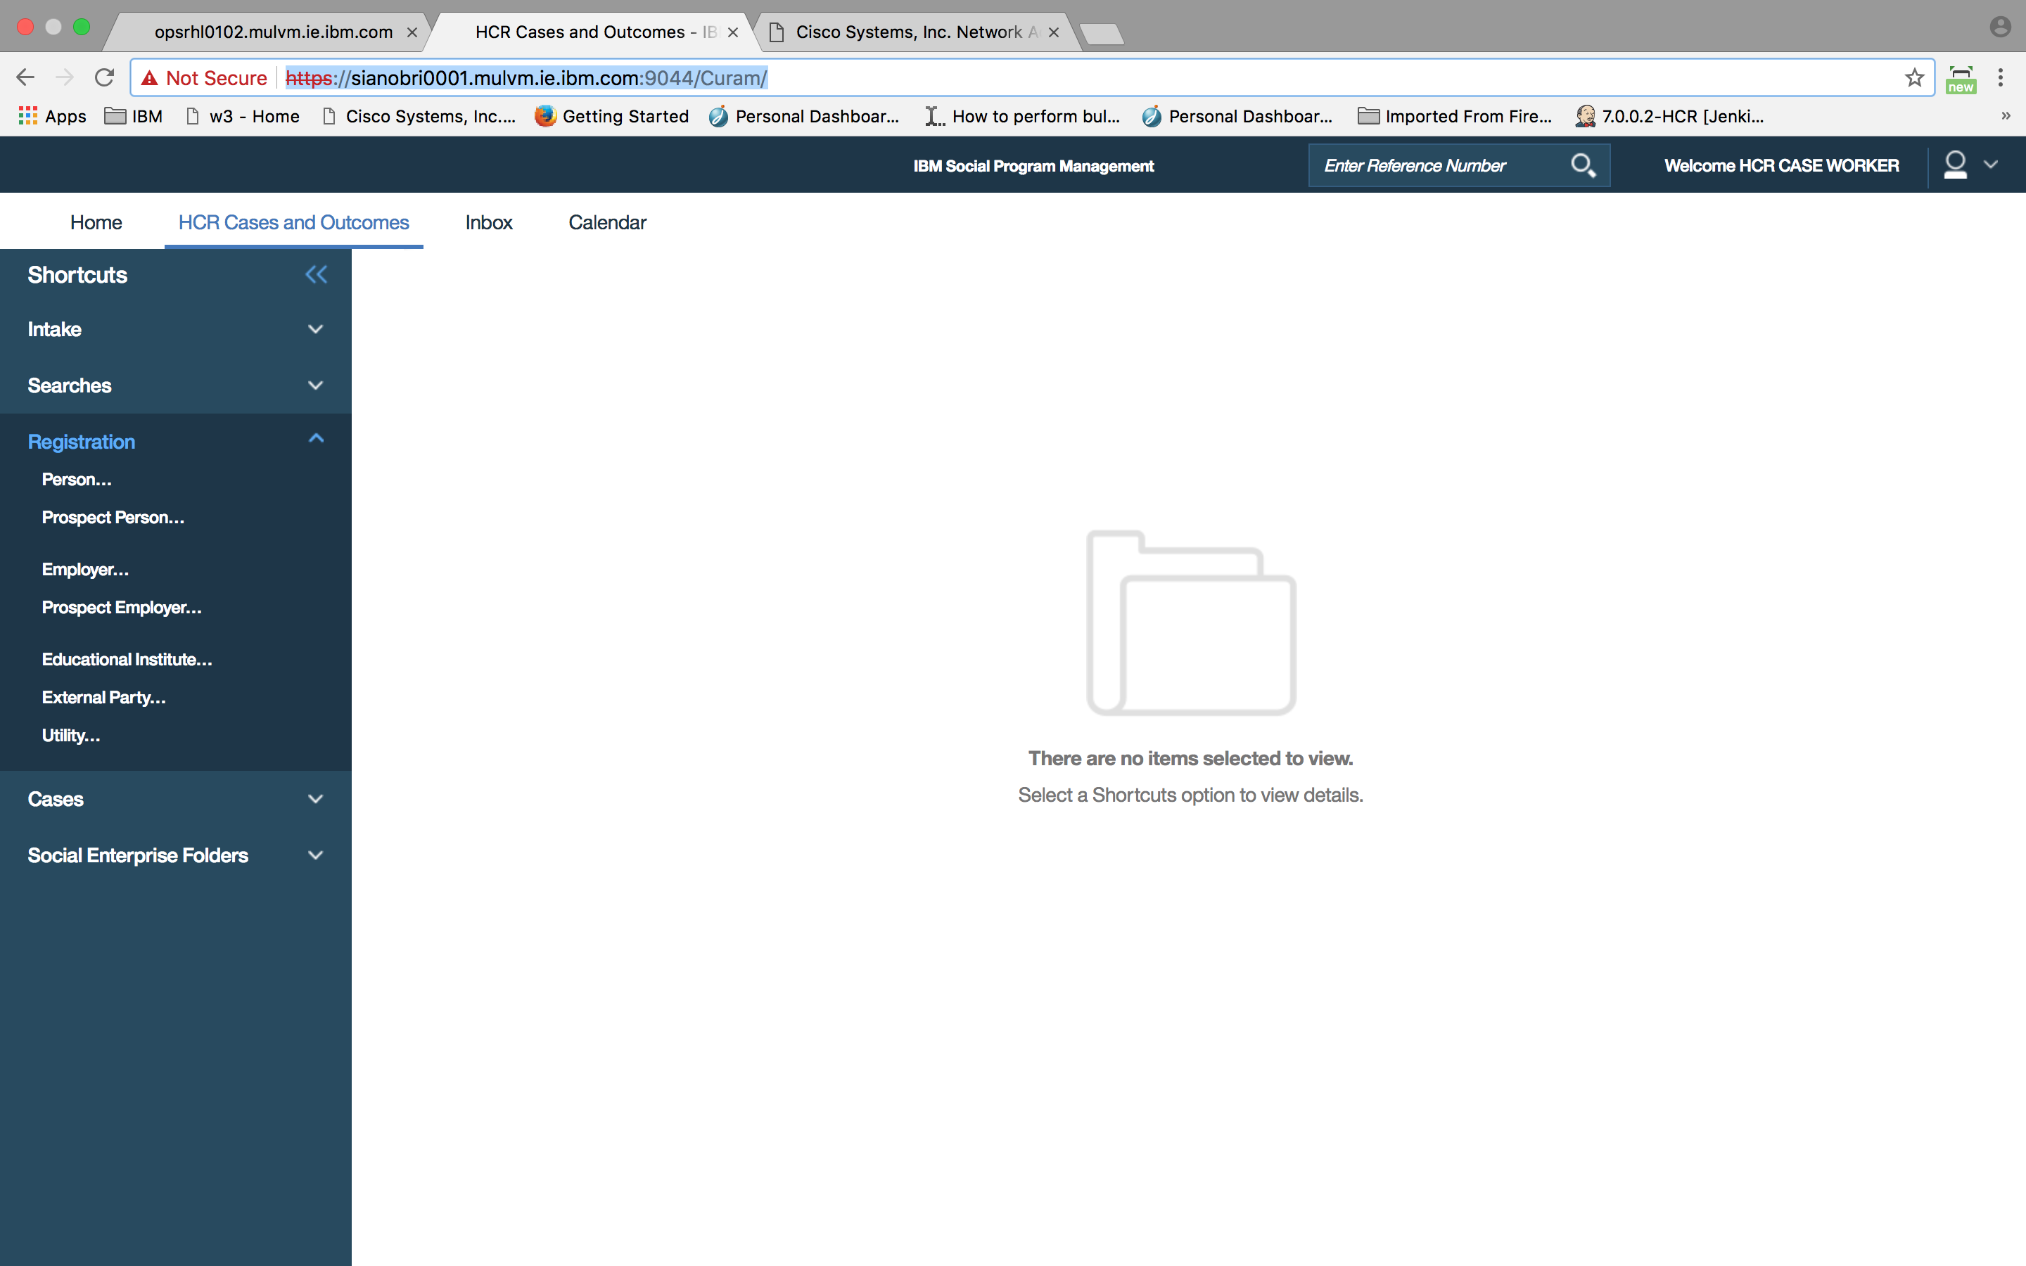
When no application tab opened, after escaping the focus goes at the top of the
browser
Notes:
To the browser title on top of the browser when no application tab are open.

Slide 6
Initial investigations
Initial business and technical investigations have been done.
A high level estimate of 12 weeks.
The change is pervasive and fix will affect all modals in the application. We need to factor in testing on all stacks.
Notes:
We need to be careful with addressing the issue, when we change the modal infrastructure it will affect all modals in the application. We need to consider all use cases and test them after the change.

Slide 7
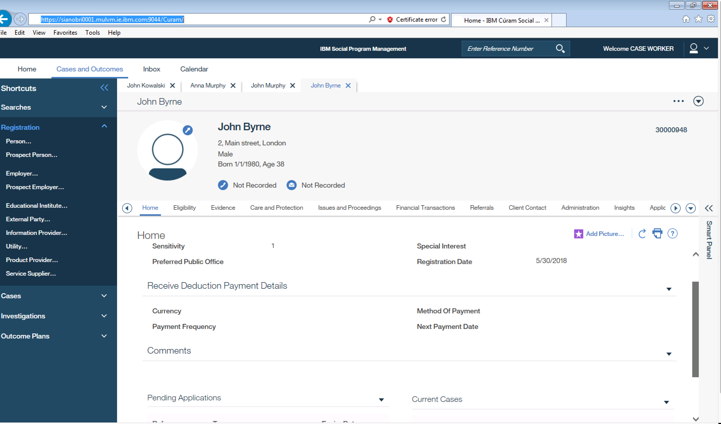
Registering Person
Notes:
When new person is registered the modal is closed and new content is loaded – the focus goes to browser, it should be placed on the new tab that have been loaded on top level.

Slide 8
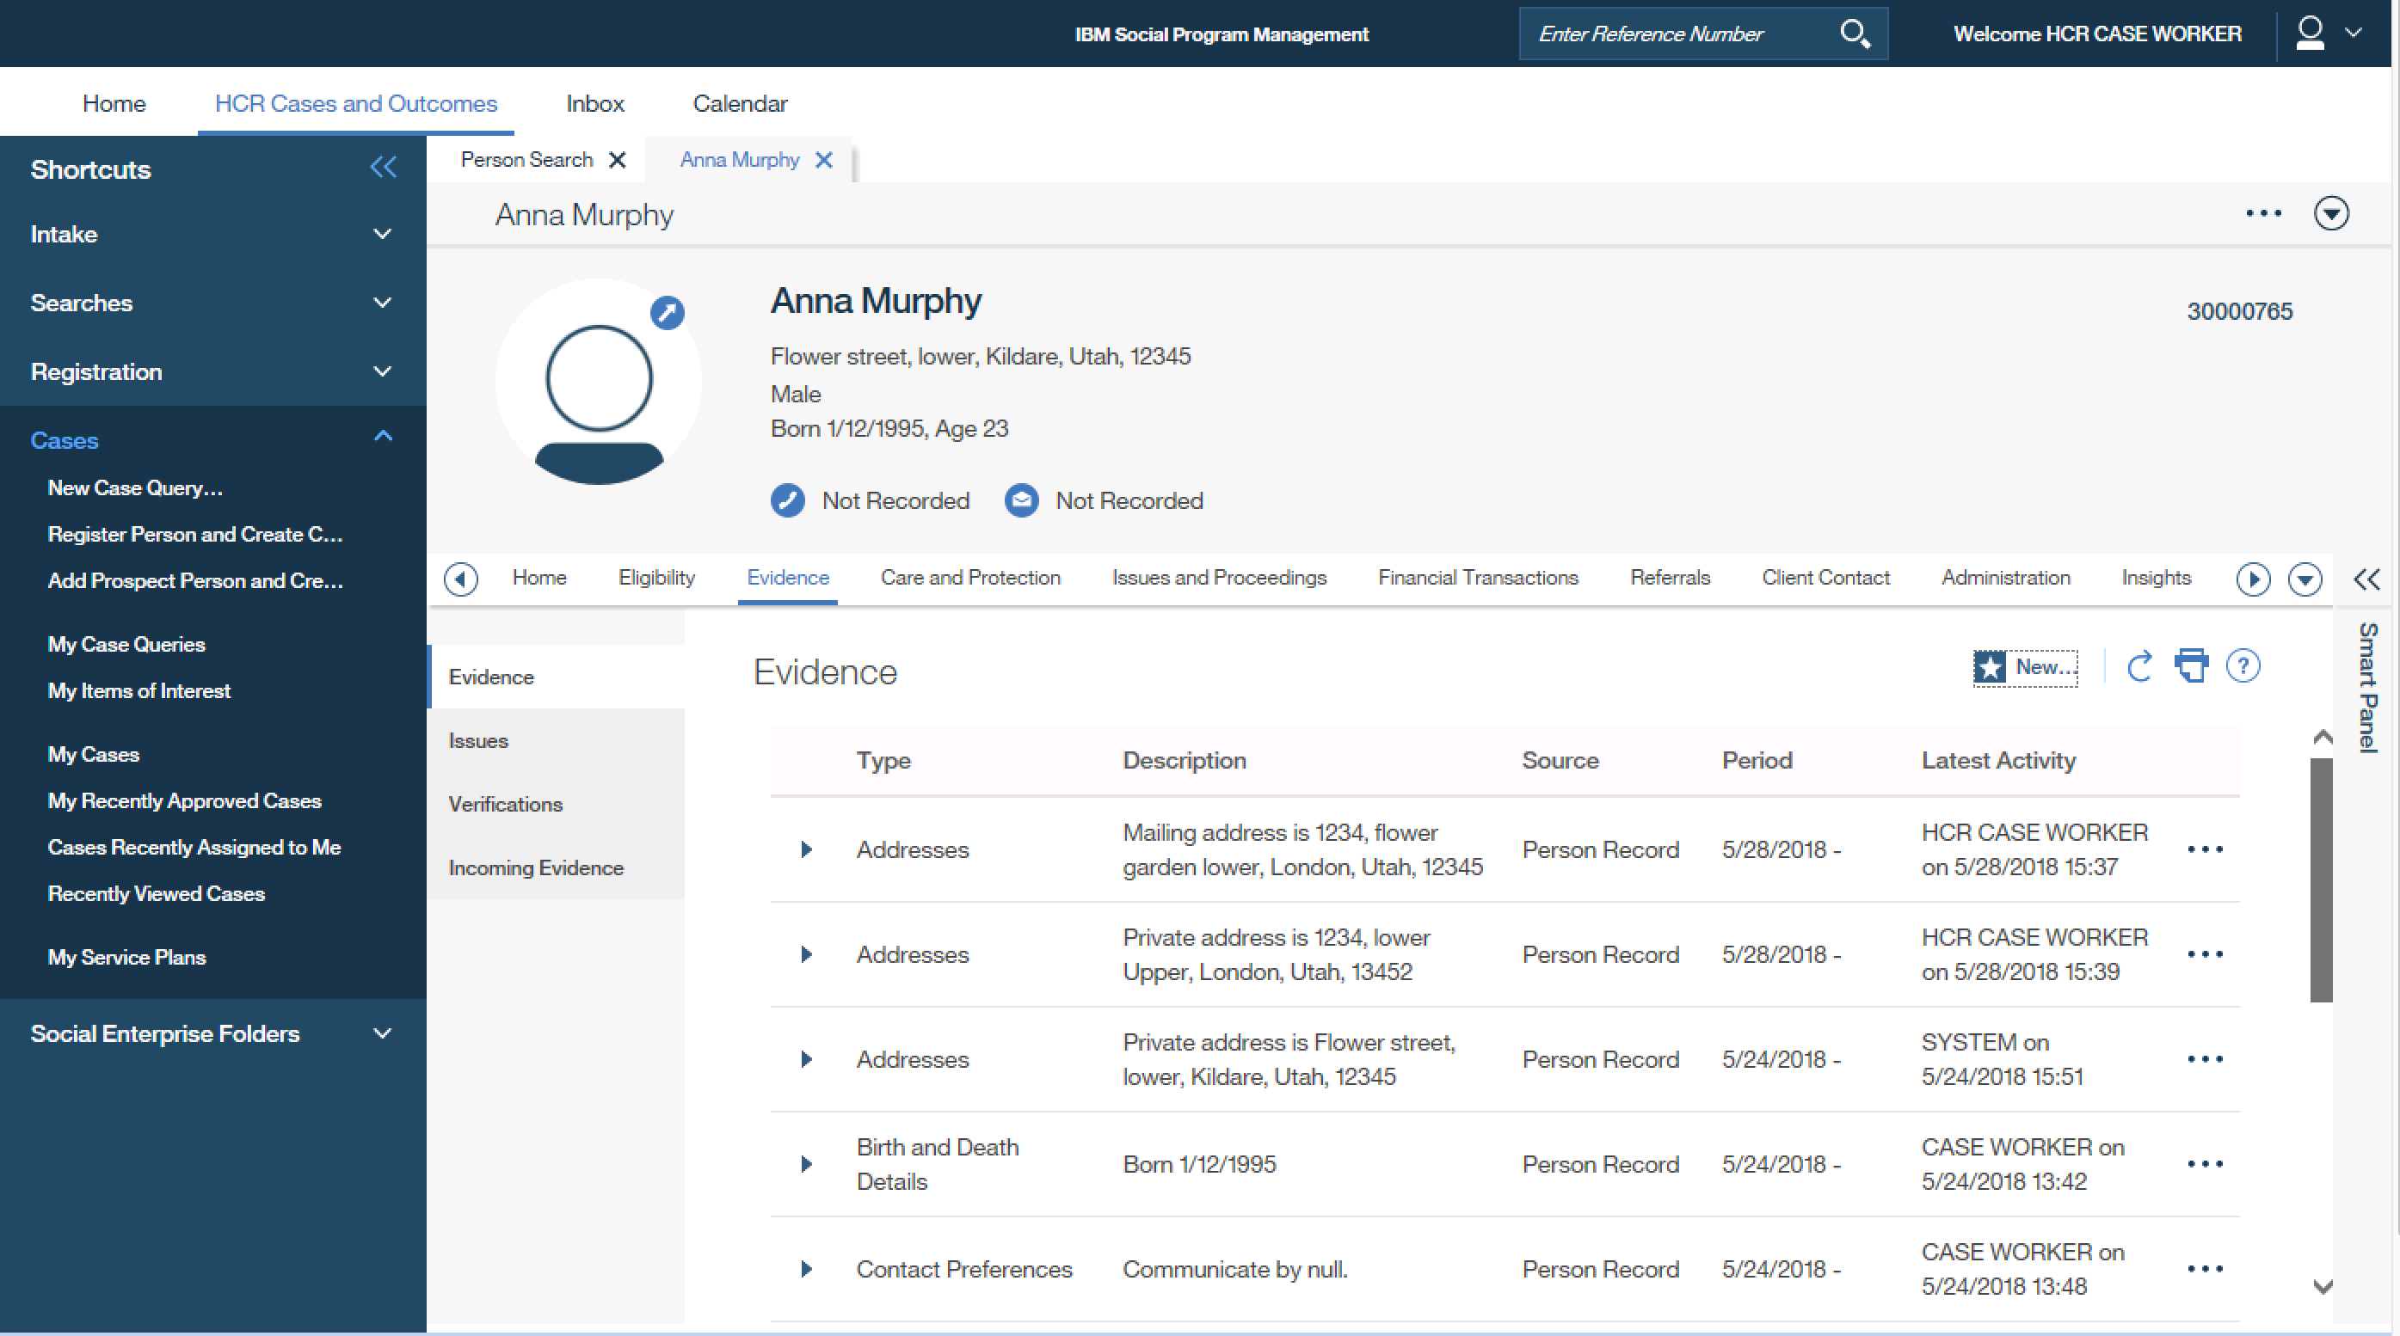
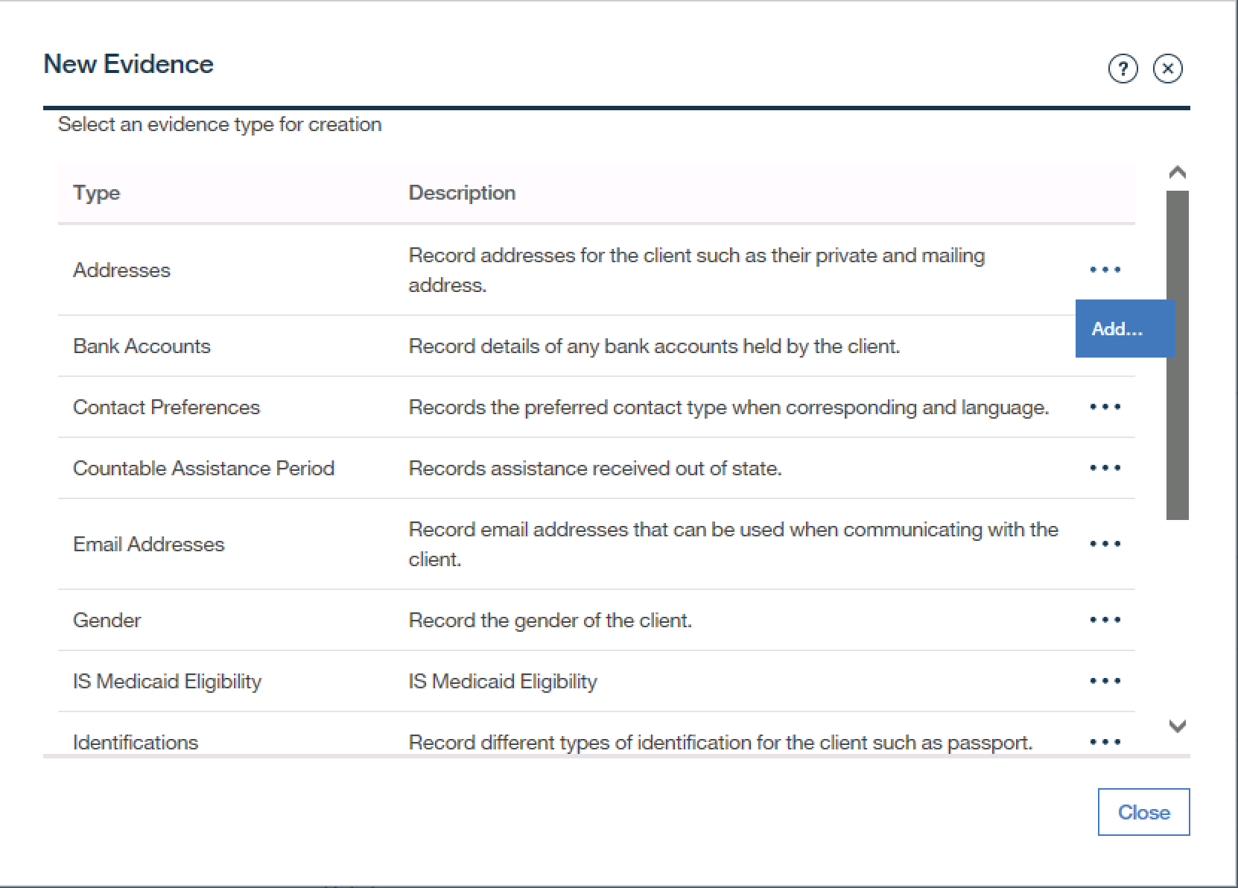
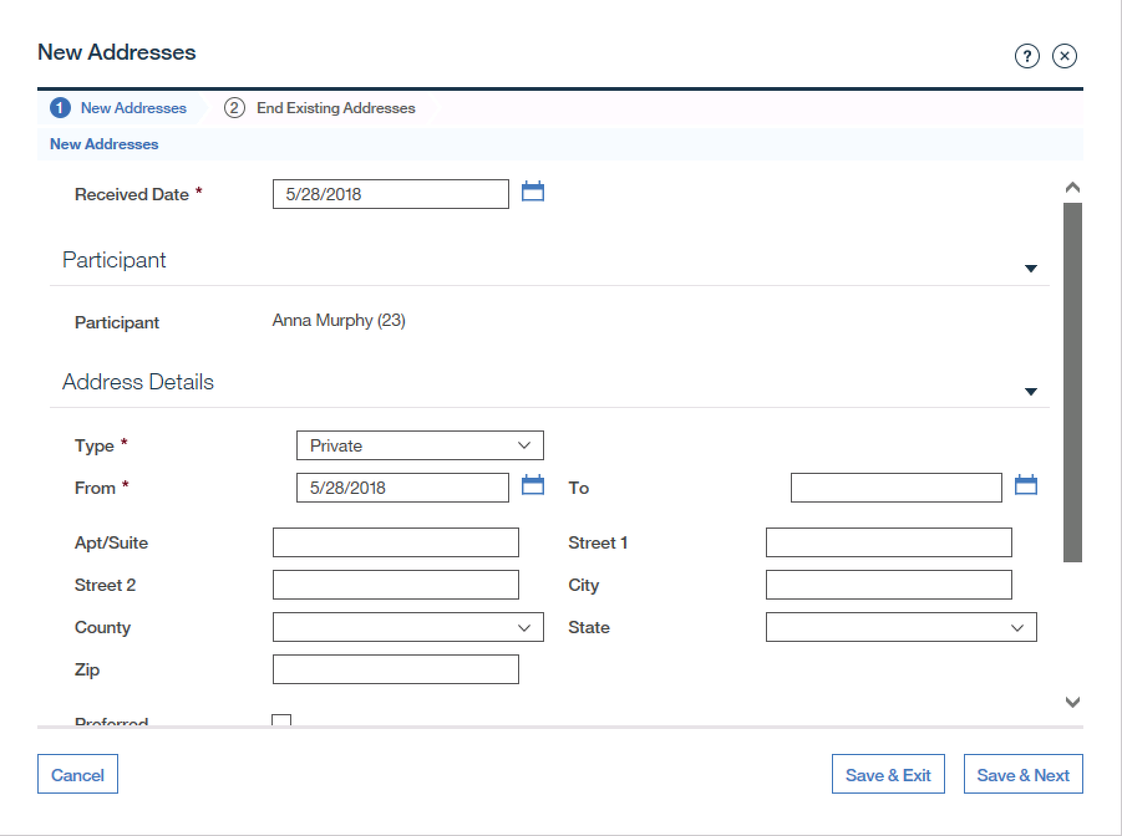
Adding new evidence
Notes:
Another scenario we need to consider is adding new evidence. User launches a modal with new evidence list , then on this modal user click add to open second modal with a new evidence he /she needs to add. At the moment after escaping the modal the focus returns to new evidence button that is used to launch first modal.

